Slide 1

Chapter 7
ARP and RARP
Objectives
Upon completion you will be able to:
Understand the need for ARP
Understand the cases in which ARP is used
Understand the components and interactions in an ARP package
Understand the need for RARP

Slide 2
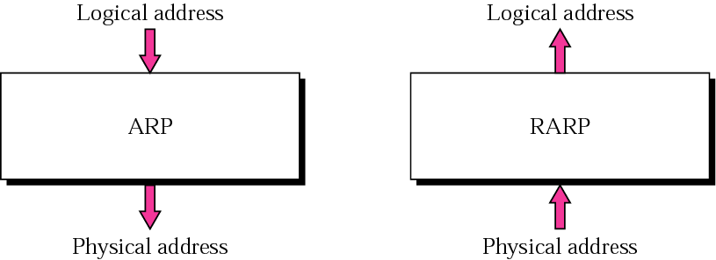
Figure 7.1 ARP and RARP

Slide 3
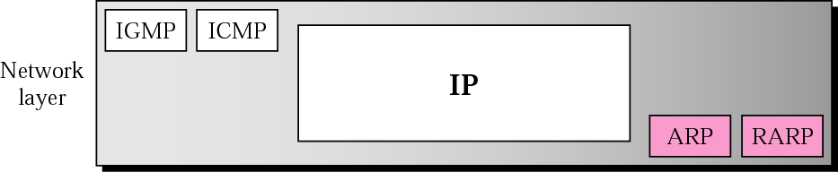
Figure 7.2 Position of ARP and RARP in TCP/IP protocol suite
Notice that ARP and RARP are supplemental to IP.

Slide 4
7.1 ARP
ARP associates an IP address with its physical address. On a typical physical network, such as a LAN, each device on a link is identified by a physical or station address that is usually imprinted on the NIC.
Logical address to physical address translation can be
done statically (not practical) or dynamically (with ARP).

Slide 5
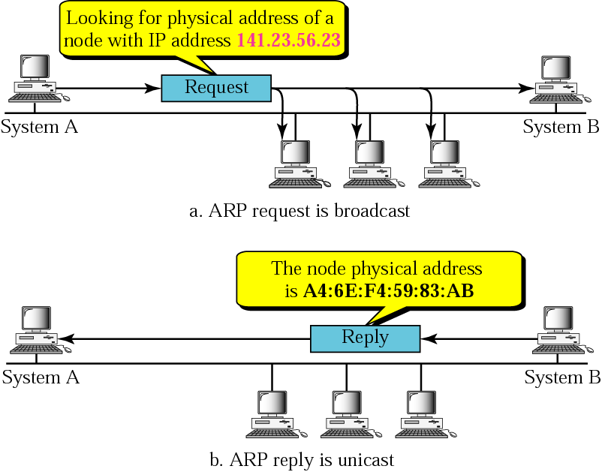
Figure 7.3 ARP operation

Slide 6
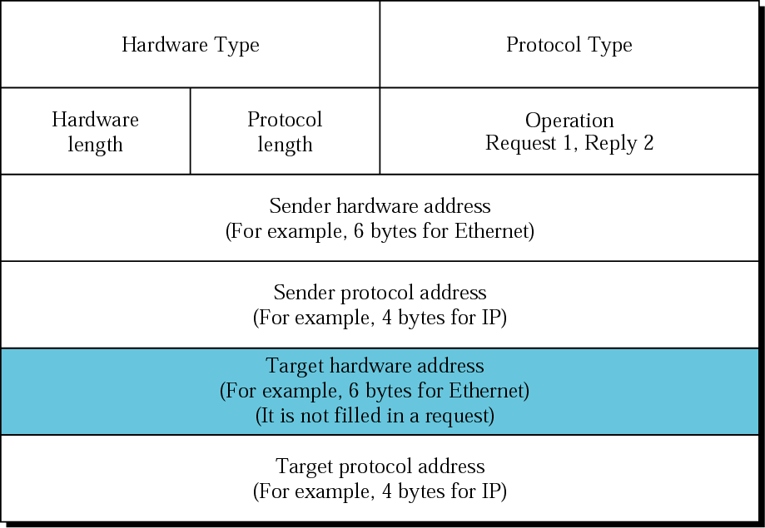
Figure 7.4 ARP packet
Hardware
Type - Ethernet
is type 1
Protocol Type-
IPv4=x0800
Hardware
Length:length of
Ethernet
Address (6)
Protocol
Length:length of
IPv4 address (4)

Slide 7
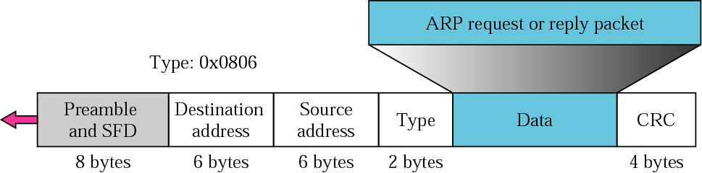
Figure 7.5 Encapsulation of ARP packet
The ARP packet is encapsulated within an Ethernet packet.
Note: Type field for Ethernet is x0806

Slide 8
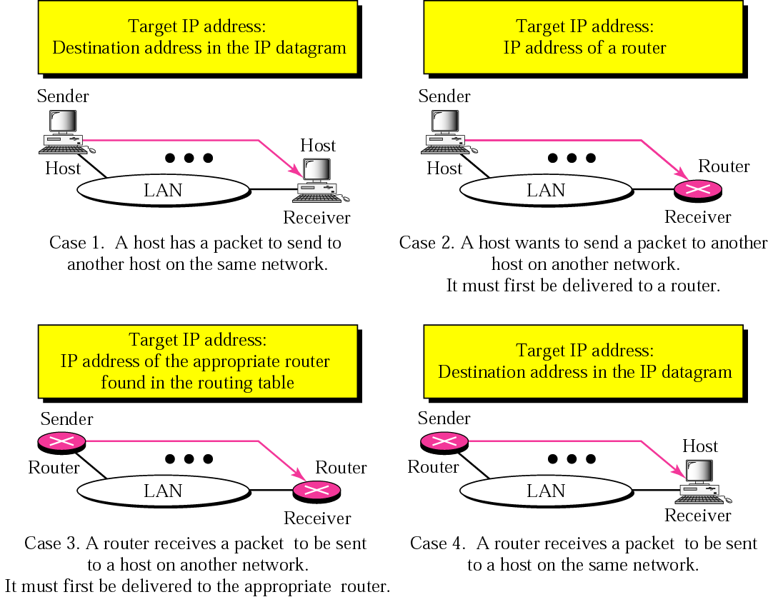
Figure 7.6 Four cases using ARP

Slide 9
Example 1
A host with IP address 130.23.43.20 and physical address B2:34:55:10:22:10 has a packet to send to another host with IP address 130.23.43.25 and physical address A4:6E:F4:59:83:AB (which is unknown to the first host). The two hosts are on the same Ethernet network. Show the ARP request and reply packets encapsulated in Ethernet frames.
See Next Slide

Slide 10
Example 1 (Continued)
Solution
Figure 7.7 shows the ARP request and reply packets. Note that the ARP data field in this case is 28 bytes, and that the individual addresses do not fit in the 4-byte boundary. That is why we do not show the regular 4-byte boundaries for these addresses. Also note that the IP addresses are shown in hexadecimal. For information on binary or hexadecimal notation see Appendix B.
See Next Slide

Slide 11
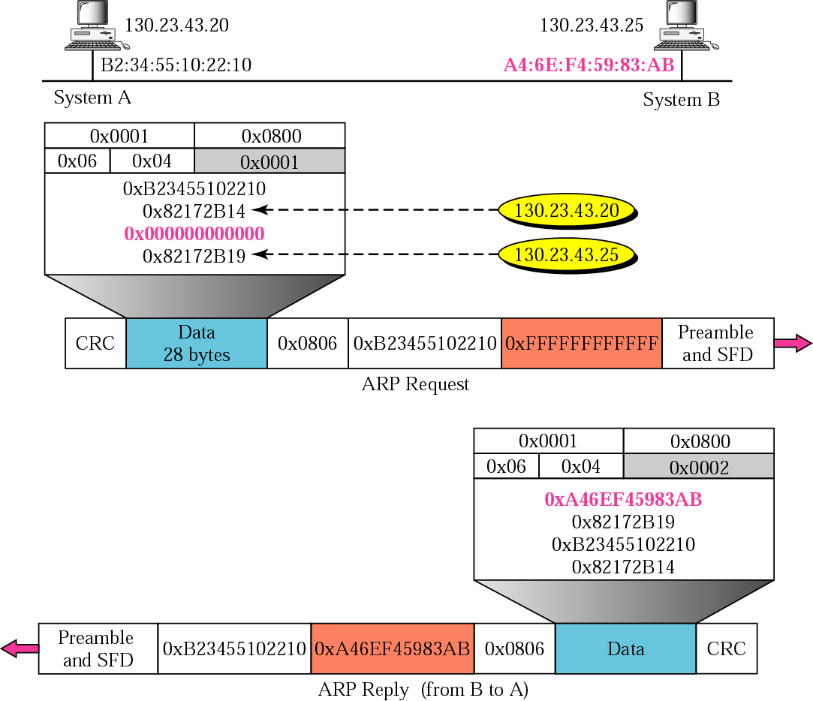
Figure 7.7 Example 1

Slide 12
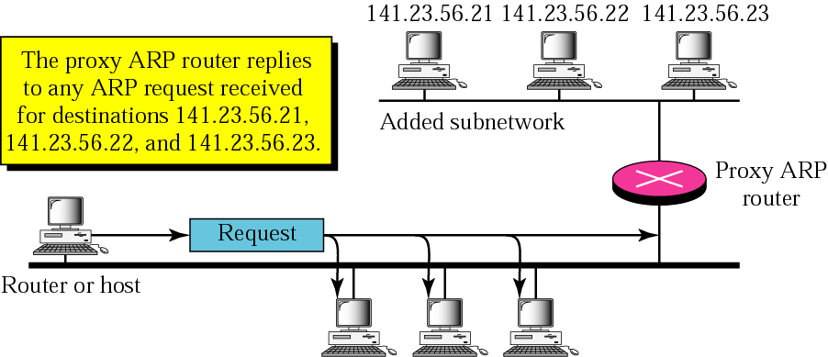
Figure 7.8 Proxy ARP
A proxy ARP, running in a router, can respond to an ARP
request for any of its proteges. The proxy ARP replies
with its own MAC address. When the packet arrives, the
router delivers it to the appropriate host.

Slide 13
7.2 ARP PACKAGE
In this section, we give an example of a simplified ARP software package to show the components and the relationships between the components. This ARP package involves five modules: a cache table, queues, an output module, an input module, and a cache-control module.
The topics discussed in this section include:
Cache Table
Queues
Output Module
Input Module
Cache-Control Module

Slide 14
The Cache Table
If ARP just resolved an IP address, chances are a few moments later someone is going to ask to resolve the same IP address
When ARP returns a MAC address, it is placed in a cache. When the next request comes in for the same IP address, look first in the cache

Slide 15
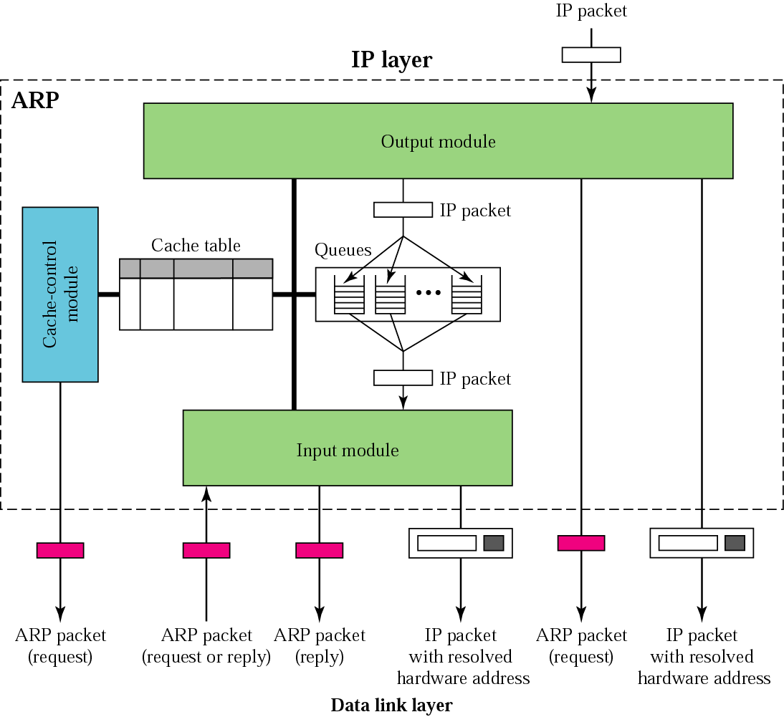
Figure 7.9 ARP components

Slide 16
The Cache Table Contents
State: FREE, PENDING, RESOLVED
Hardware type: same as ARP field
Protocol type: same as ARP field
Hardware length: same as ARP field
Protocol length: same as ARP field
Interface number: port number (m0,m1, m2)

Slide 17
The Cache Table Contents
Queue number: which queue the ARP request is sitting in
Attempts: how many times have you tried to resolve this address?
Time-out: how long until this address is tossed out (need the room in cache)
Hardware address: destination hardware address
Protocol address: destination IP address

Slide 18
How Does the Cache Work?
The output module waits for an IP packet with a request
Checks the cache for an existing entry
If entry found and state RESOLVED, we already have this MAC address
If entry found and state PENDING, packet waits until dest hard addr found

Slide 19
How Does the Cache Work?
If no entry found, output module places this request in queue, and a new entry is placed in cache with state PENDING and ATTEMPTS set to 1. An ARP request is then broadcast

Slide 20
How Does the Cache Work?
The input module waits until an ARP request or reply arrives
Module checks the cache for this entry
If entry is found and state is PENDING, module updates entry’s target hardware address, changes state to RESOLVED, and sets the TIME-OUT value

Slide 21
How Does the Cache Work?
If entry is found and state RESOLVED, module still updates the entry (target hardware address could have changed) and the TIME-OUT value reset
If entry not found, module creates a new entry. State is set to RESOLVED and TIME-OUT is set

Slide 22
How Does the Cache Work?
Now the module checks to see if arrived ARP packet is a Request. If it is, the module immediately creates an ARP Reply message and sends it back to sender.

Slide 23
How Does the Cache Work?
The cache-control module periodically checks each cache entry
If entry’s state is FREE, skips it
If entry’s state is PENDING, Attempts field is incremented by 1. This value greater than max? Toss this entry (and mark entry as FREE). Less than max? Send another ARP request

Slide 24
How Does the Cache Work?
If state of entry is RESOLVED, module decrements value of Time-out field accordingly
If Time-out field < 0, then remove entry and set state to FREE

Slide 25
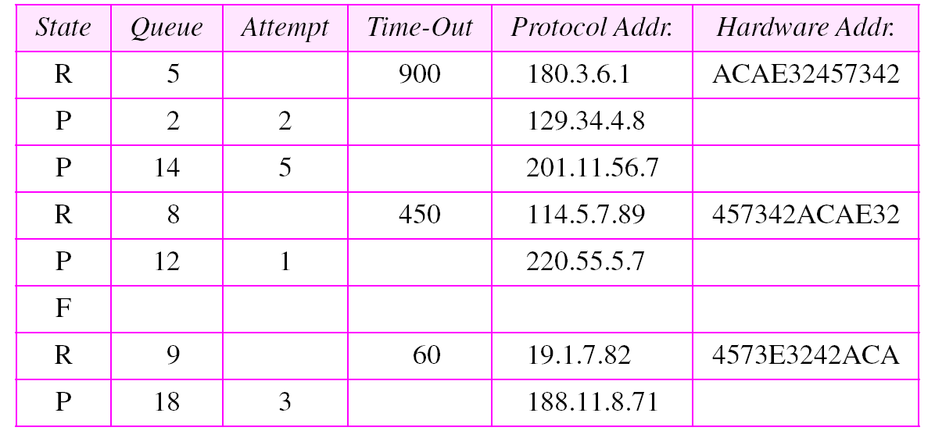
Table 7.1 Original cache table used for examples

Slide 26
Example 2
The ARP output module receives an IP datagram (from the IP layer) with the destination address 114.5.7.89. It checks the cache table and finds that an entry exists for this destination with the RESOLVED state (R in the table). It extracts the hardware address, which is 457342ACAE32, and sends the packet and the address to the data link layer for transmission. The cache table remains the same.

Slide 27
Example 3
Twenty seconds later, the ARP output module receives an IP datagram (from the IP layer) with the destination address 116.1.7.22. It checks the cache table and does not find this destination in the table. The module adds an entry to the table with the state PENDING and the Attempt value 1. It creates a new queue for this destination and enqueues the packet. It then sends an ARP request to the data link layer for this destination. The new cache table is shown in Table 7.2.
See Next Slide

Slide 28
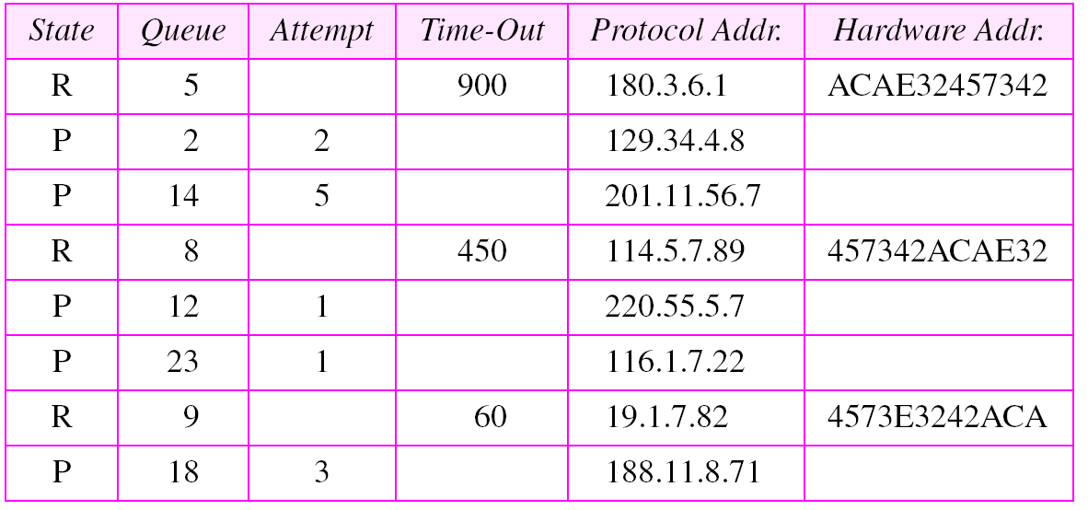
Table 7.2 Updated cache table for Example 3

Slide 29
Example 4
Fifteen seconds later, the ARP input module receives an ARP packet with target protocol (IP) address 188.11.8.71. The module checks the table and finds this address. It changes the state of the entry to RESOLVED and sets the time-out value to 900. The module then adds the target hardware address (E34573242ACA) to the entry. Now it accesses queue 18 and sends all the packets in this queue, one by one, to the data link layer. The new cache table is shown in Table 7.3.
See Next Slide

Slide 30
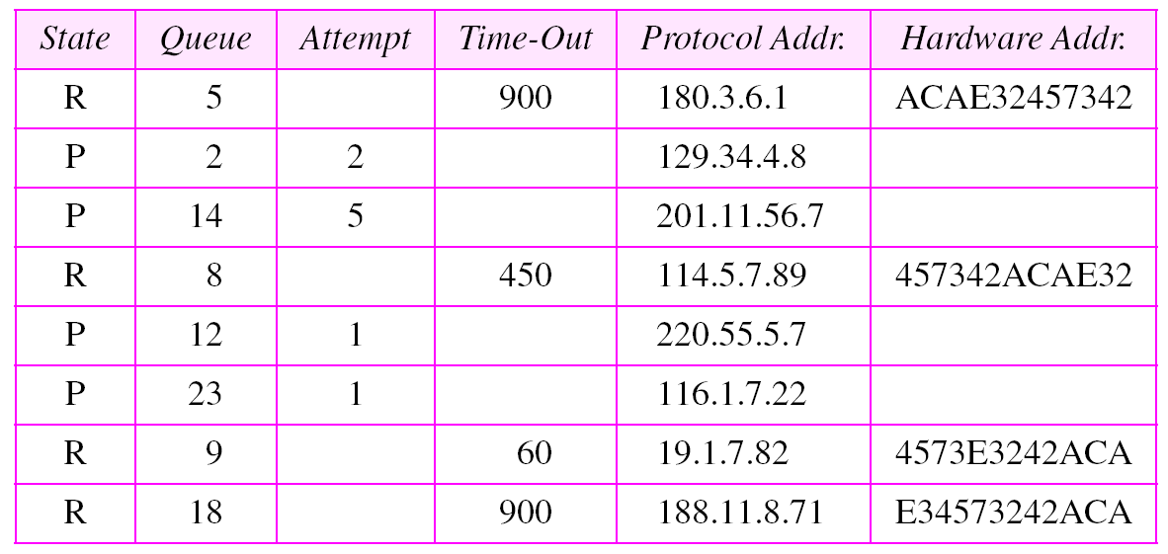
Table 7.3 Updated cache table for Example 4

Slide 31
Example 5
Twenty-five seconds later, the cache-control module updates every entry. The time-out values for the first three resolved entries are decremented by 60. The time-out value for the last resolved entry is decremented by 25. The state of the next-to-the last entry is changed to FREE because the time-out is zero. For each of the three pending entries, the value of the attempts field is incremented by 1. One entry (IP addr 201.1.56.7 is over max, so change to FREE.
See Next Slide

Slide 32
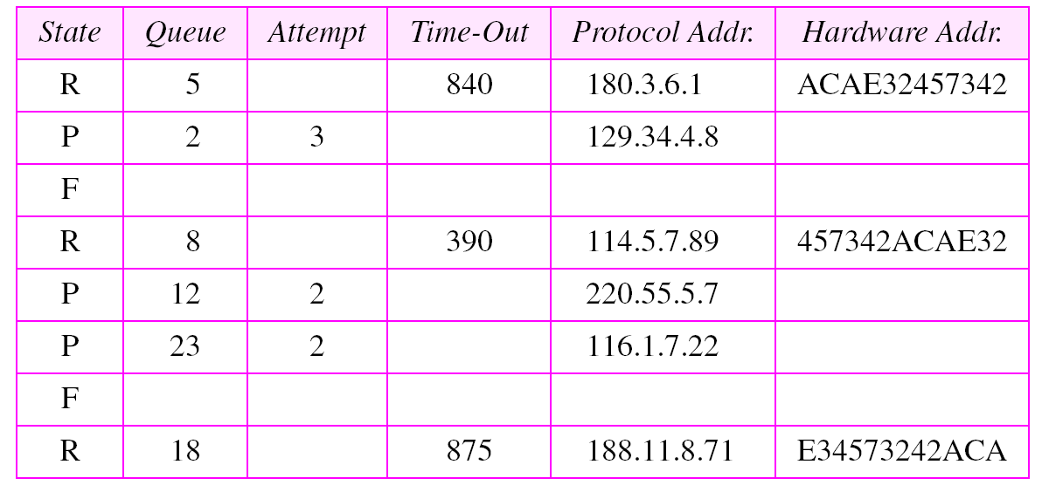
Table 7.4 Updated cache table for Example 5

Slide 33
7.3 RARP
RARP finds the logical address for a machine that only knows its physical address.
This if often encountered on thin-client workstations. No disk, so when
machine is booted, it needs to know its IP address (don’t want to burn
the IP address into the ROM).
RARP requests are broadcast, RARP replies are unicast.
If a thin-client workstation needs to know its IP address, it probably
also needs to know its subnet mask, router address, DNS address, etc.
So we need something more than RARP. BOOTP, and now DHCP have
replaced RARP.

Slide 34
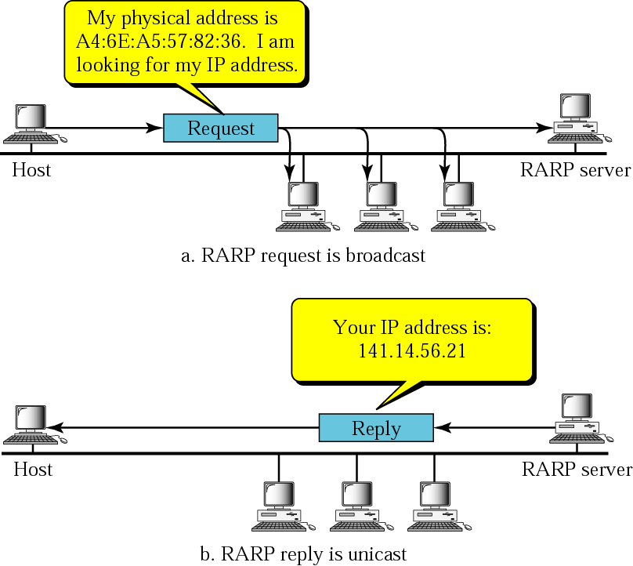
Figure 7.10 RARP operation

Slide 35
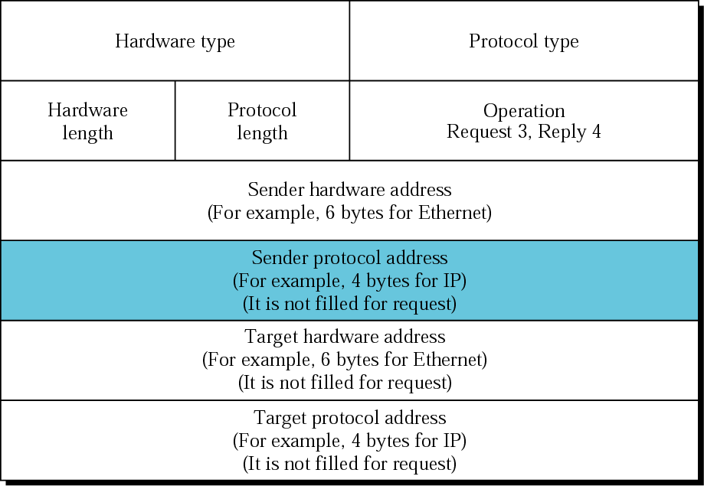
Figure 7.11 RARP packet

Slide 36
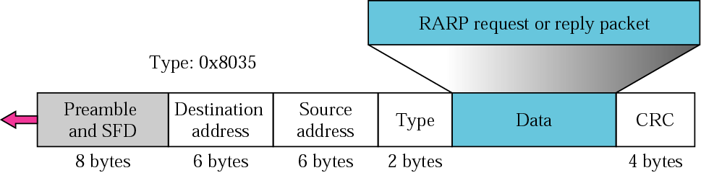
Figure 7.12 Encapsulation of RARP packet

